Slide 1
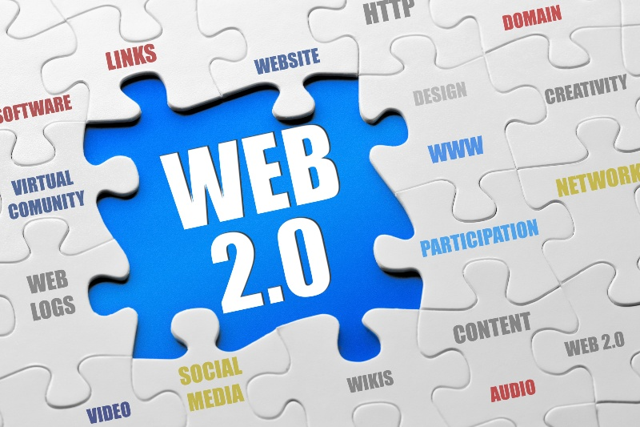
By: Brea Sabatka

Slide 2
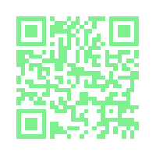
What is Web 2.0?
Web 2.0 - is the second stage of development of the World Wide Web, characterized esp. by the change from static web pages to dynamic or user-generated content and the growth of social networking
Website explaining what web 2.0 is.

Slide 3
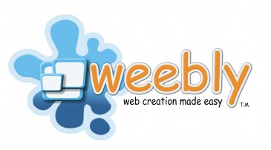
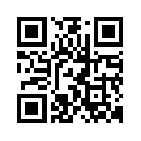
Weebly allows you to make your own website. Here is a link to my personal website.

Slide 4
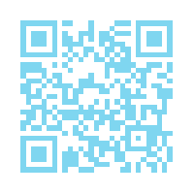
Social Networking: Sites that connect individuals in a community, allowing them to communicate with friends, colleagues and even strangers. The most popular examples are MySpace, Facebook and Twitter.
Students can do discussion over twitter by hash tagging the topic. Here is a QR code on twitter using #web2.0

Slide 5
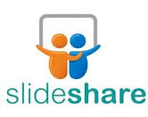
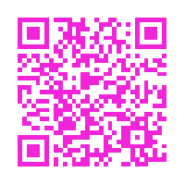
Presentation Tools
Slideshare – a way to upload your PowerPoint and share it.
Prezi – different way of slideshow on a giant online canvas
Picsviewr – Looking to jazz up your presentation? Just export and upload it to this website and add some touches.

Slide 6
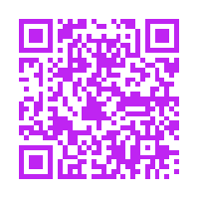
Video Tools
Video integration tools for classroom projects and presentations.
Animoto.com
Animoto.com/education
PhotoPeach.com – allows you to create slideshows with built in polls and quizzes.

Slide 7
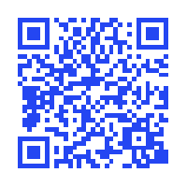
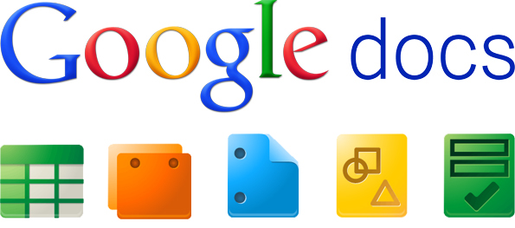
Community Tools
Video on the community tools →
Examples:
Edmodo.com – social platform for students & teachers.
Google Docs - allows users to create and edit documents online while collaborating with other users live
Wikispaces.com
Ning.com – create your own social network.
Classroom 2.0 – Online community for teachers.

Slide 8
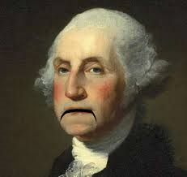
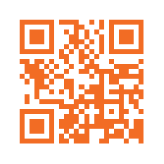
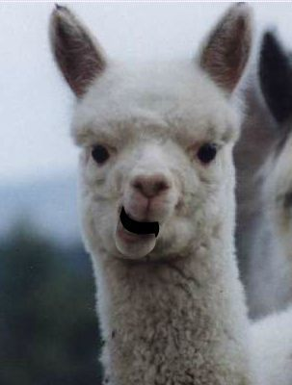
Blabberize - free web 2.0 tool that allows you to quickly and painlessly create talking photos. Simply upload a photo of your choice, select the photo’s mouth or jaw, and record your audio.
Blabberize
When to use it in the classroom:
Have students research a historical figure and then create a Blabber introducing that person to the class.
Have students create Blabbers introducing themselves to each other.
Use Blabbers to make important classroom and homework announcements entertaining.

Slide 9
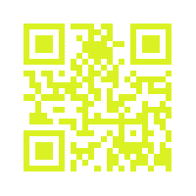
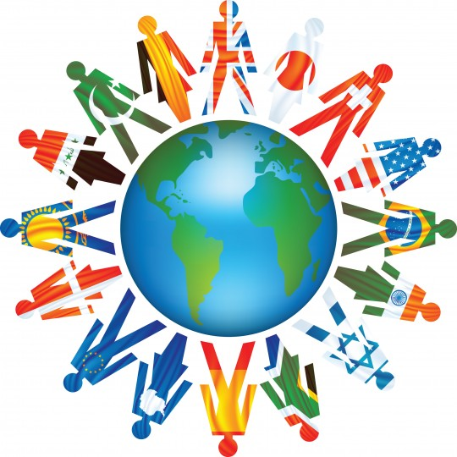
My favorite Web 2.0 tool
The Web’s largest and fastest-growing community of connecting school classrooms delivers supervised and protected e-mail, blogs and collaborative forums help schools connect with each other to learn about another culture, share curriculum projects, practice literacy and foreign language, work on science experiments or discuss world events.
ePals.com is my favorite tool because I think it would be great for the kids to be able to speak with children from other countries during social studies or Spanish.

Slide 10
Reflection
Overall I thought the doing the PowerPoint over Web 2.0 and the QR codes was fun. At first it was a little challenging to decide what was important to put onto it. I found a ton of stuff that I had never heard of before while doing it which was pretty cool. When I become a teacher, there are cool tools online for students to use. I really like the ePals, which was where the teacher can connect with another classroom across the country and have a lesson. Another cool one is Google Docs, which can be used for documents like word, PowerPoint, and stuff like that.
I would use QR codes in the classroom when students are doing projects that call for presentations. I think it would be more useful for students in higher grade levels because most students at those ages have smart phones. In a lot of elementary schools they now have iPods and iPads for students to use in the class. So for presentations they could do kind of what we did, and the students could use the QR codes for looking into the information that the presenters put on there.

