Slide 1
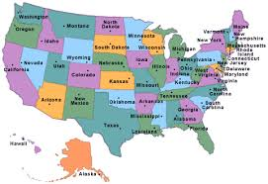
States and Capitals

Slide 2
What is the capital of Nebraska?
Omaha
Lincoln
York

Slide 3
Good job! Yes, Lincoln is the capital of Nebraska! Next please!

Slide 4
Oops. Try again.

Slide 5
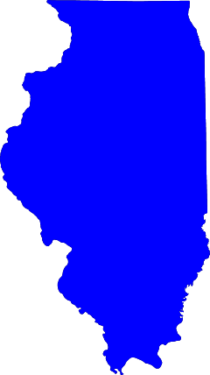
What is the capital of Illinois?

